Slide 1
INTRODUCTION TO INNOVATION, IP MANAGEMENT & ENTREPRENEURSHIP
MGT-207
Dr. SHOBHANA.N
Faculty,
School of Management,
SASTRA Deemed to be University,
shobhana@mba.sastra.edu

Slide 2
UNIT - III
Entrepreneurship:
Opportunity recognition and entry strategies –
Effectuation –
Design thinking –
Lean Start-up –
Developing Business Model –
Entrepreneurship as a Style of Management – value proposition –
Maintaining Competitive Advantage –
Financial Plan: Start up, operating and variable costs and Project appraisal: NPV, IRR, BCR techniques –
Projections and Valuation Stages of financing: Debt, Venture Capital and other forms of Financing.
Entrepreneurship- Financial Planning: Break even analysis: Profit volume ratio, selling price determination, cash flow statement analysis, Ratio analysis

Slide 3


Slide 4


Slide 5


Slide 6


Slide 8


Slide 9


Slide 10


Slide 11
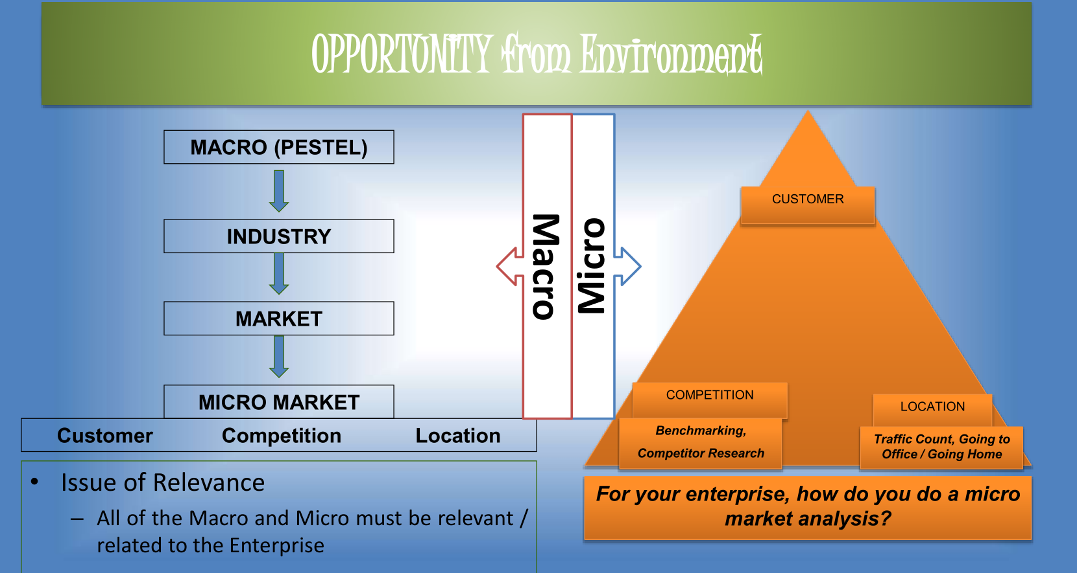

Slide 12
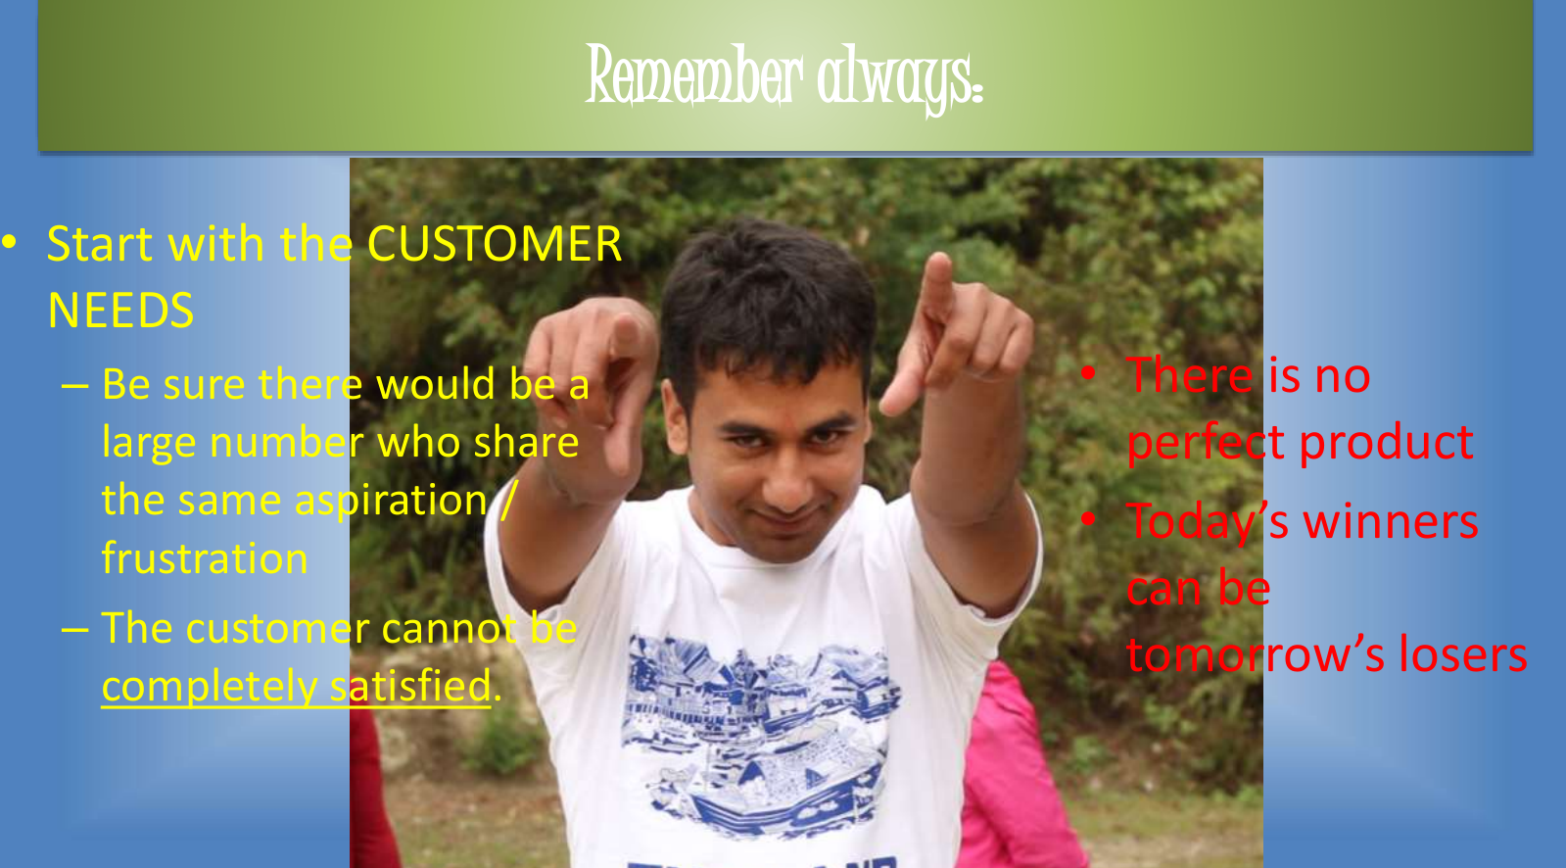

Slide 13
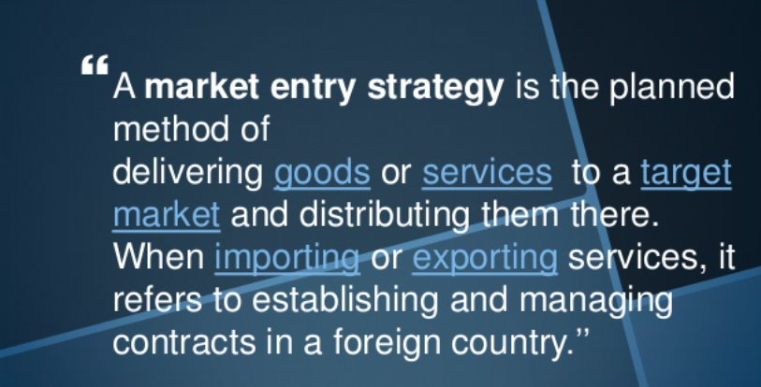
MARKET ENTRY STRATEGY

Slide 14
Sole Proprietorship
Sole proprietorship means a business owned, financed and controlled by a single person who is recipient of all profit and bearer of all risks.
It is SUITABLE IN AREAS OF PERSONALISED SERVICE like beauty parlour, hair cutting saloons & small scale activities like retail shops.
Features
1. Single ownership: It is wholly owned by one individual. 2. Control: Sole proprietor has full power of decision making. 3. No separate legal entity: Legally there is no difference between business& businessmen. 4. Unlimited liability: The liability of owner is unlimited. In case the assets of business are not sufficient to meet its debts, the personal property of owner can be used for paying debts 5. No legal formalities: Not required to start, manage and dissolve such business organization. 6. Sole risk bearer and profit recipient: He bears the complete risk and there is no body to share profit/loss with him.

Slide 15
PARTNERSHIP
Meaning: Partnership is a voluntary association of two or more persons who agree to carry on some business jointly and share its profits and losses.
FEATURES
1. Two or more persons: There must be at least two persons to form a partnership. The maximum no. of persons is 10 in banking business and 20 in non-banking business. 2. Agreement: It is an outcome of an agreement among partners which may be oral or in writing. 3. Lawful business- It can be formed only for the purpose of carrying on some lawful business. 4. Decision making & control – Every partner has a right to participate in management & decision making of the organisations. 5. Unlimited liability – Partners have unlimited liability. 6. Mutual Agency – Every partner is an implied agent of the other partners and of the firm. Every partner is liable for acts performed by other partners on behalf of the firm. 7. Lack of continuity – Firms existence is affected by the death, Lunacy and insolvency of any of its partner. It suffers from lack of continuity.

Slide 16
TYPES OF PARTNERS
1. General / Active Partner – Such a partner takes active part in the management of the firm. 2. Sleeping or Dormant Partner – He does not take active part in the management of the firm. Though he invested money, shares profit & Loss and unlimited liability. 3. Secret Partner – He participates in business secretly without disclosing his association with the firm to general public. His liability is also unlimited. 4. Nominal Partner – Such a partner only gives his name and goodwill to the firm. He neither invests money nor takes profit. But his liability is unlimited. 5. Partner by Estoppels – He is the one who by his words or conduct gives impression to the outside world that he is a partners of the firm whereas actually he is not. His liability is unlimited towards the third party who has entered into dealing with firm on the basis of his pretensions. 6. Partner by holding out – He is the one who is falsely declared partner of the firm whereas actually he is not. And even after becoming aware of it, he-does not deny it. His liability is unlimited towards the party who has deal with firm on the basis of this declaration.

Slide 17
Co-operative Society
A co-operative society is a voluntary association of persons of moderate means who unite together to protect & promote their common economic interests.
FEATURES
1. Voluntary association: Every one having a common interest is free to join a co-operative society and can also leave the society after giving proper notice.
2. Legal status: Its registration is compulsory and it gives it a separate legal identity.
3. Limited liability: The liability of the member is limited to the extent of their capital contribution in the society.
4. Democratic control: Management & Control lies with the managing committee elected by the members by giving vote. Every member has one vote irrespective of the number of shares held by him.
5. Service motive: The main aim is to serve its members and not to maximize the profit.
6. Bound by govt.’s rules: They have to be tide by the rules and regulations framed by govt. for them.
7. Distribution of surplus: The profit is distributed on the basis of volume of business transacted by a member and not on the basis of capital contribution of members.

Slide 18
TYPES OF CO-OPERATIVE SOCIETIES
1. Consumers co-operative Society – It formed to protect the interest of consumers.It seeks to eliminate middleman by establishing a direct link with the producers. It purchases goods of daily consumption directly from manufacturer or wholesalers and sells them to the members at reasonable prices.
2. Producer’s Co-operative Society – The main aim is to help small producers who cannot easily collect various items of production and face some problem in marketing. These societies purchase raw materials, tools, equipments and other items in large quantity and provide these things to their members at reasonable price.
3. Marketing Co-operative Society – It performs various marketing function such as transportation, warehousing, packing, grading, marketing research etc. for the benefit of its members. The production of different members is pooled together and sold by society at good price.

Slide 19
JOINT STOCK COMPANY
Meaning – Joint stock company is a voluntary association of persons for profit, having a capital divided into transferable shares, the ownership of which is the condition of membership.
FEATURES
1. Incorporated association – The company must be incorporated or registered tender the companies Act 1956. Without registration no company can come into existence.
2. Separate Legal Existence – It is created by law and it is a distinct legal entity independent of its members. It can own property, enter into contracts, can file suits in its own name.
3. Perpetual Existence – Death, insolvency and insanity or change of members as no effect on the life of a company. It can come to an end only through the prescribed legal procedure.
4. Limited Liability – The liability of every member is limited to the nominal value of the shares bought by him or to the amt. guaranteed by him. Transferability of shares – Shares of public Co. are easily transferable. But there are certain restrictions on transfer of share of private Co. Common Seal- It is the official signature of the company and it is affixed on all important documents of company.
5. Separation of ownership and control – Management of company is in the hands of elected representatives of shareholders known individually as director and collectively as board of directors.

Slide 20
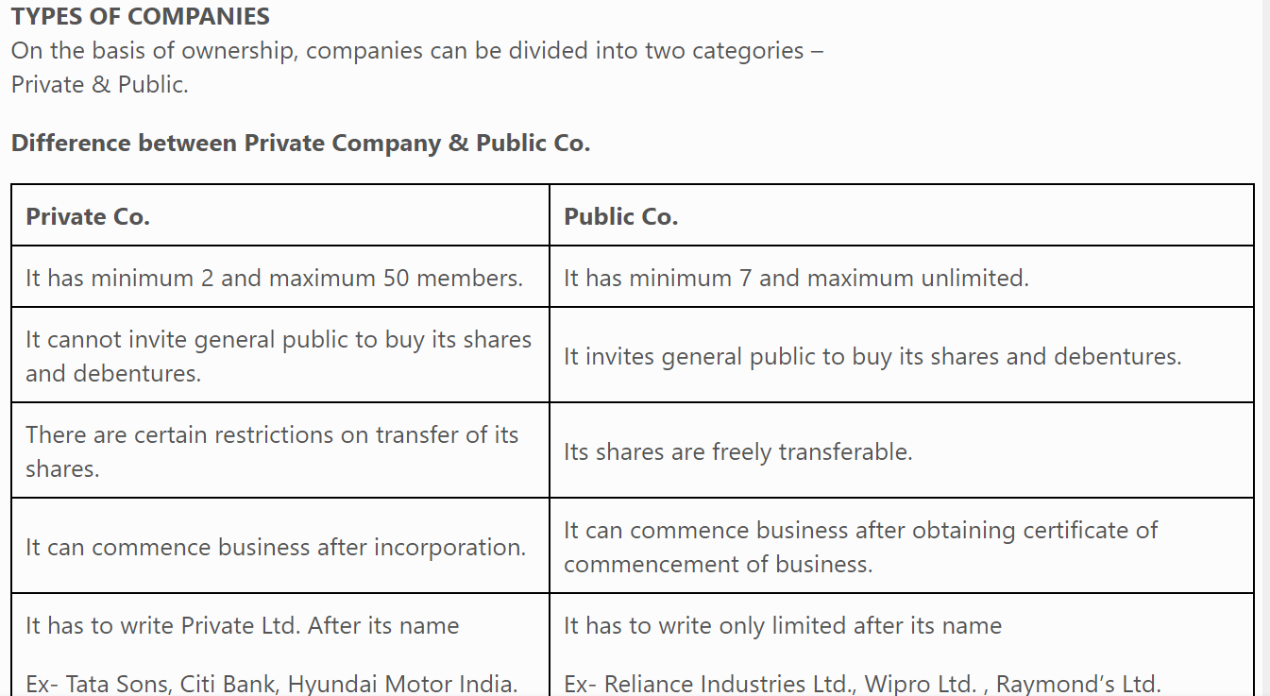
TYPES OF COMPANIES On the basis of ownership, companies can be divided into two categories – Private & Public.

Slide 21
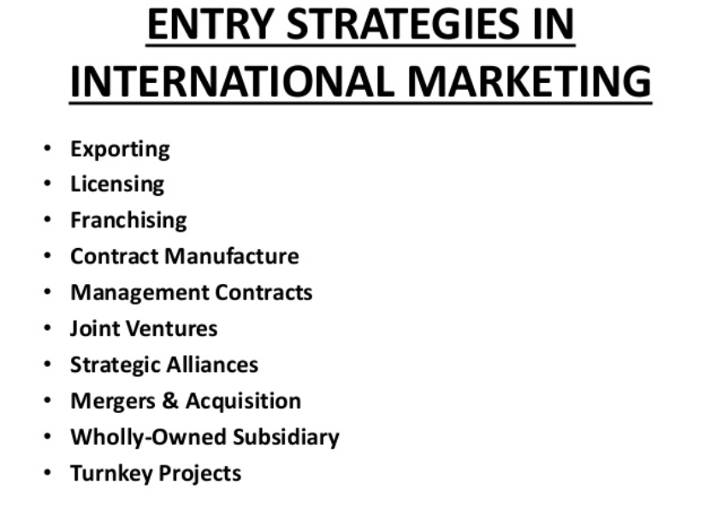

Slide 22
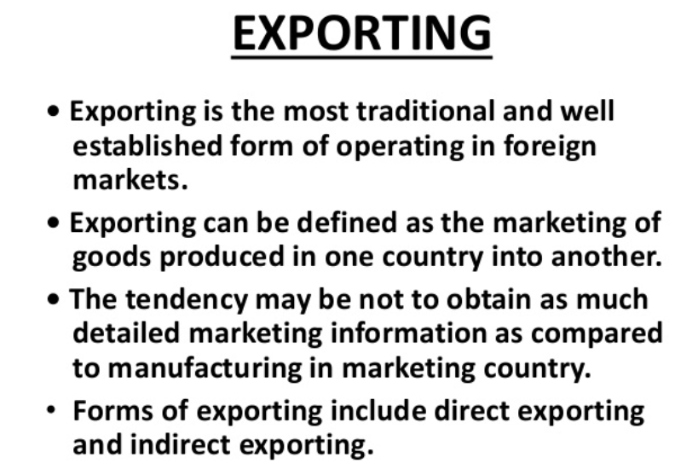

Slide 23
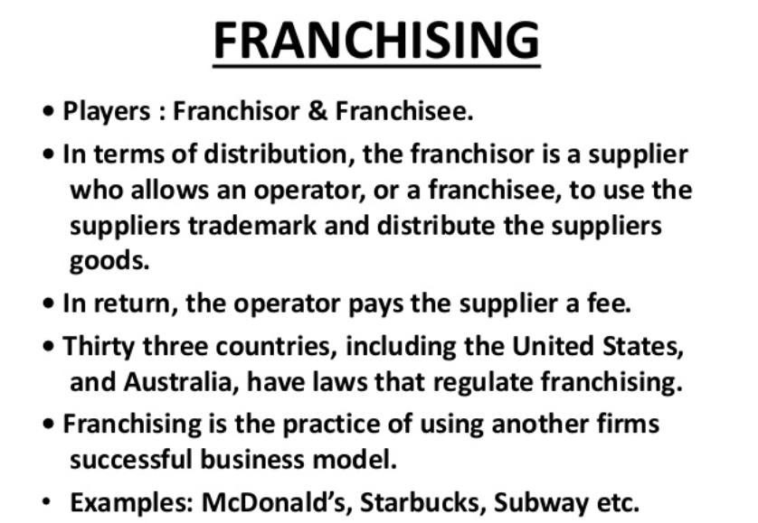

Slide 24
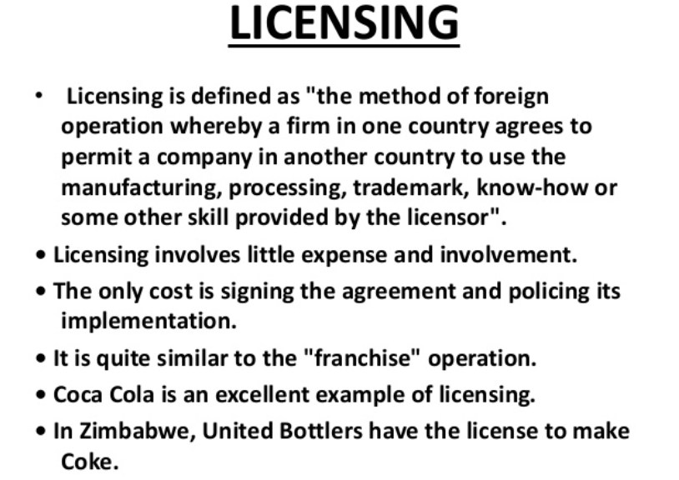

Slide 25
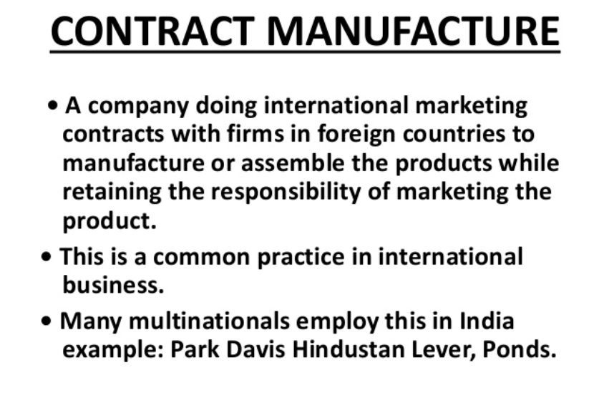

Slide 26
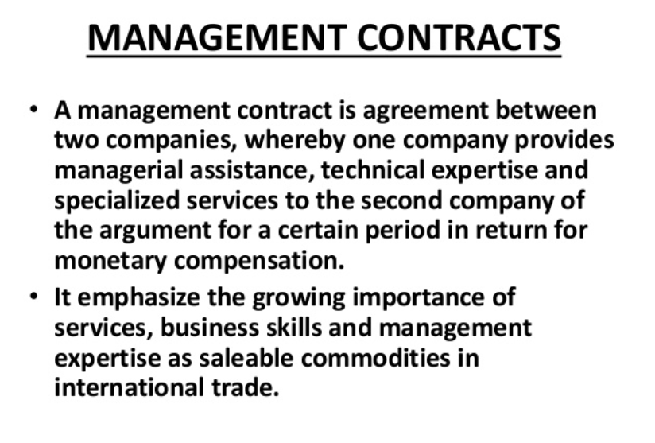

Slide 27
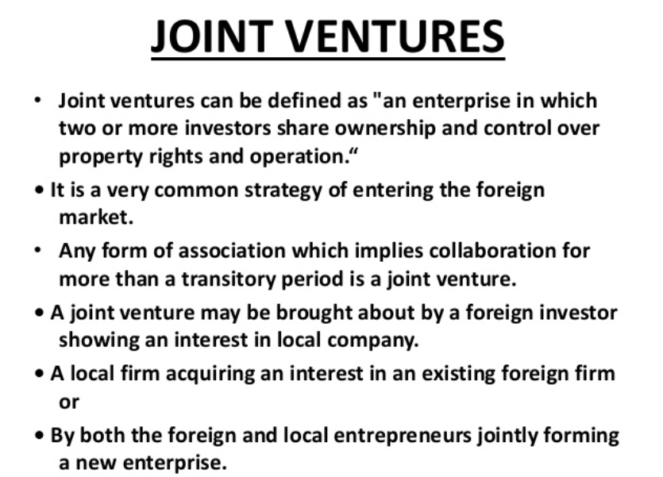

Slide 28
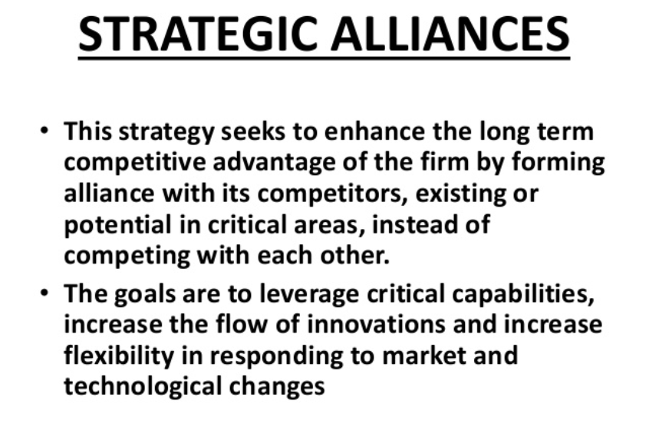

Slide 29
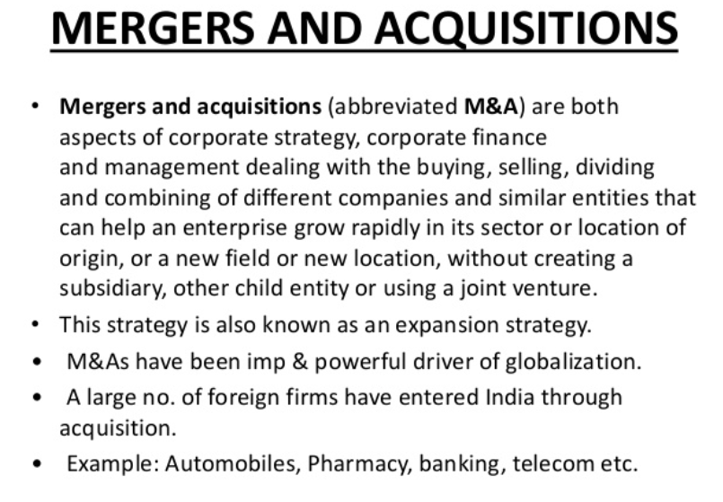

Slide 30
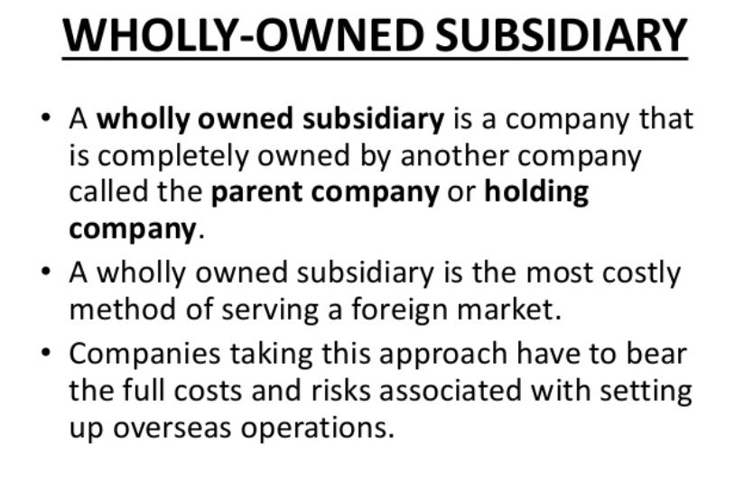

Slide 31
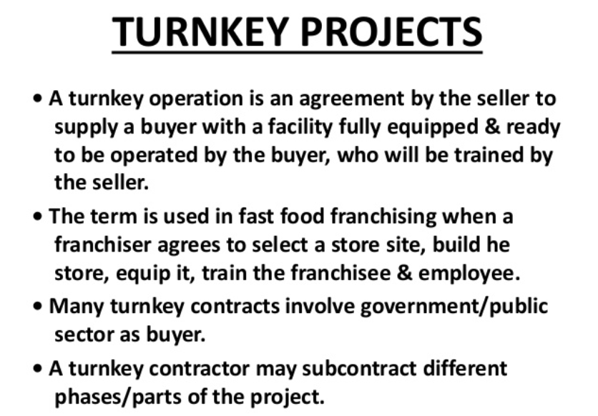

Slide 32
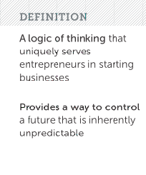
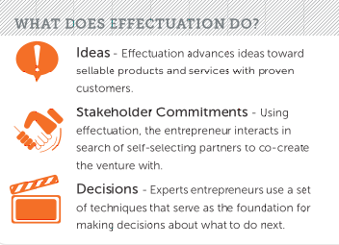
EFFECTUATION: Saras Sarasvathy’s theory of Effectuation (2001) describes an approach to making decisions and performing actions in entrepreneurship processes, where you identify the next, best step by assessing the resources available in order to achieve your goals, while continuously balancing these goals with your resources and actions.

Slide 33
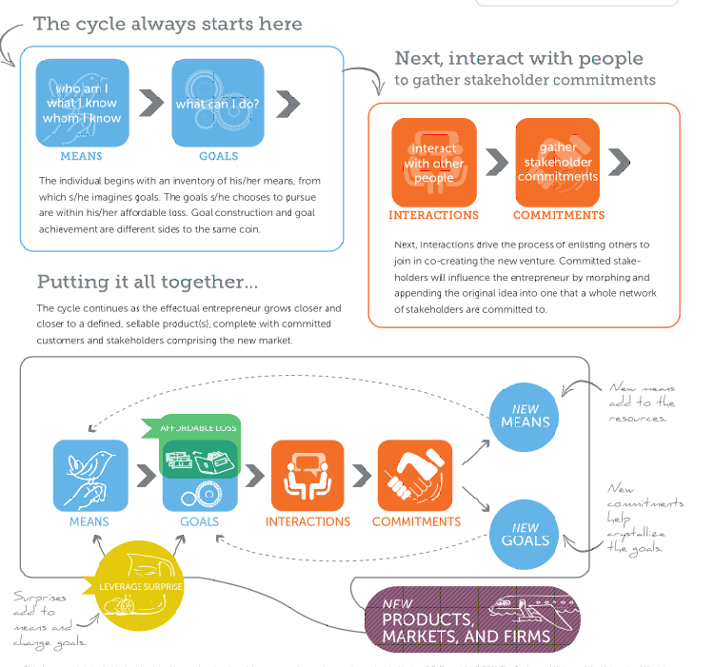

Slide 34
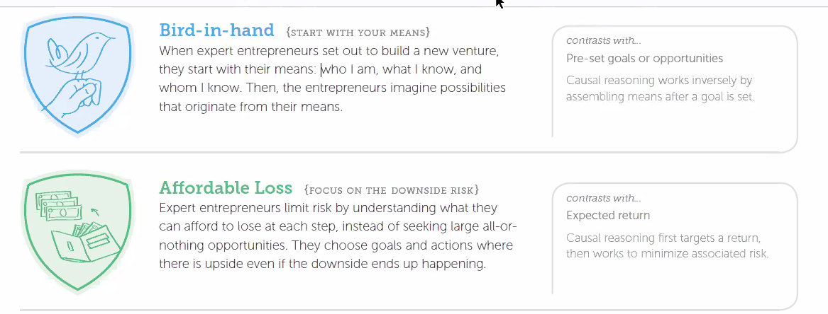

EFFECTUATION PROCESS- Dr. Saras Saraswathy

Slide 35
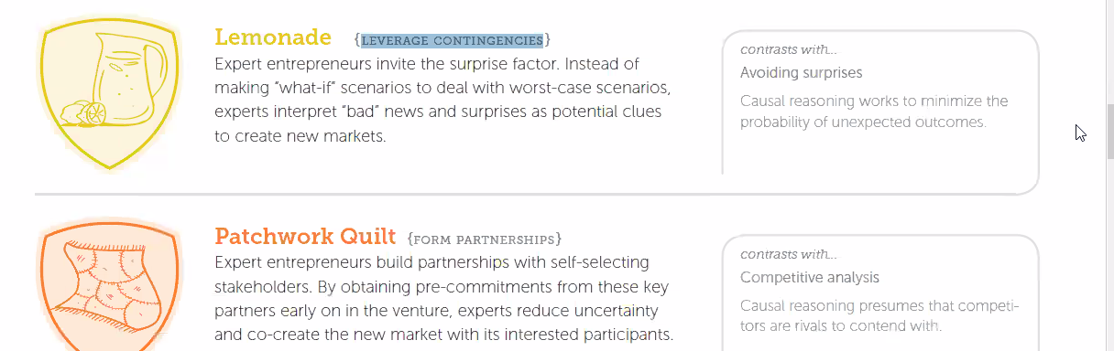


Slide 36



Slide 37
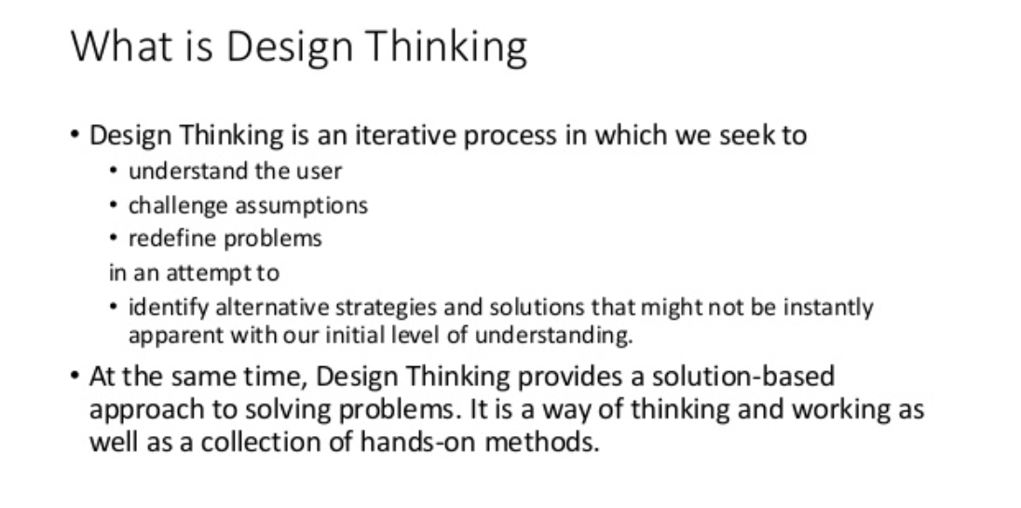


Slide 38


Slide 39
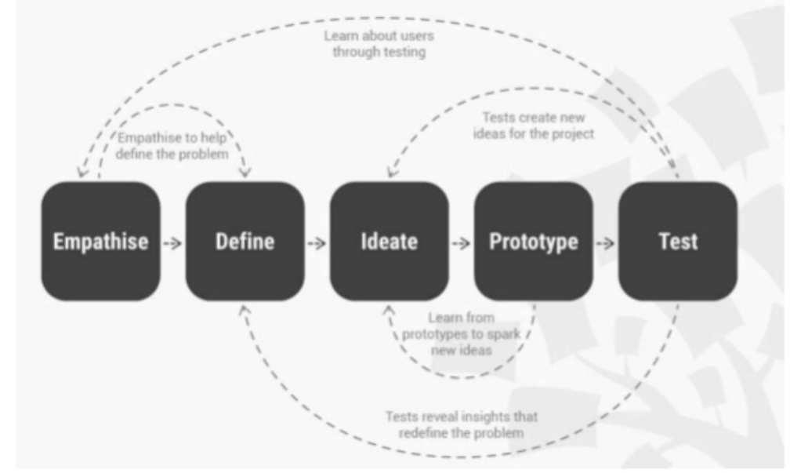

Slide 40


Slide 41
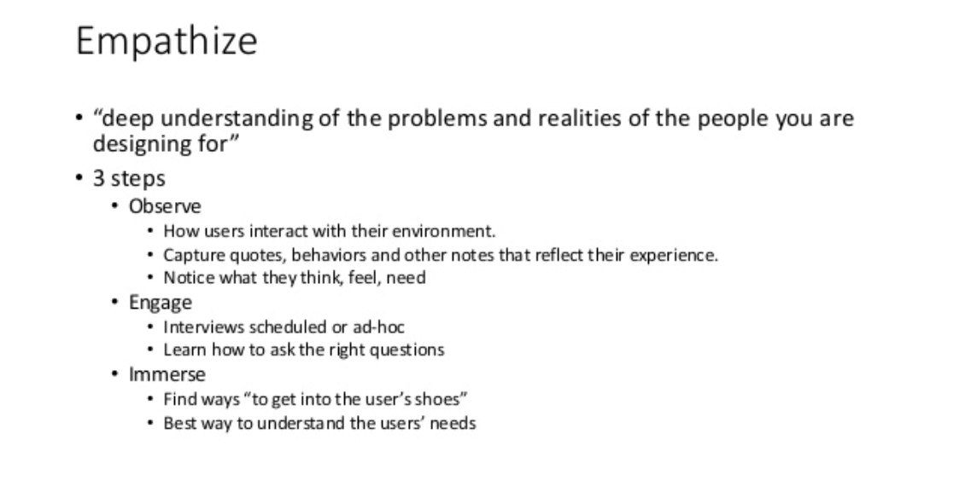



Slide 42


Slide 43
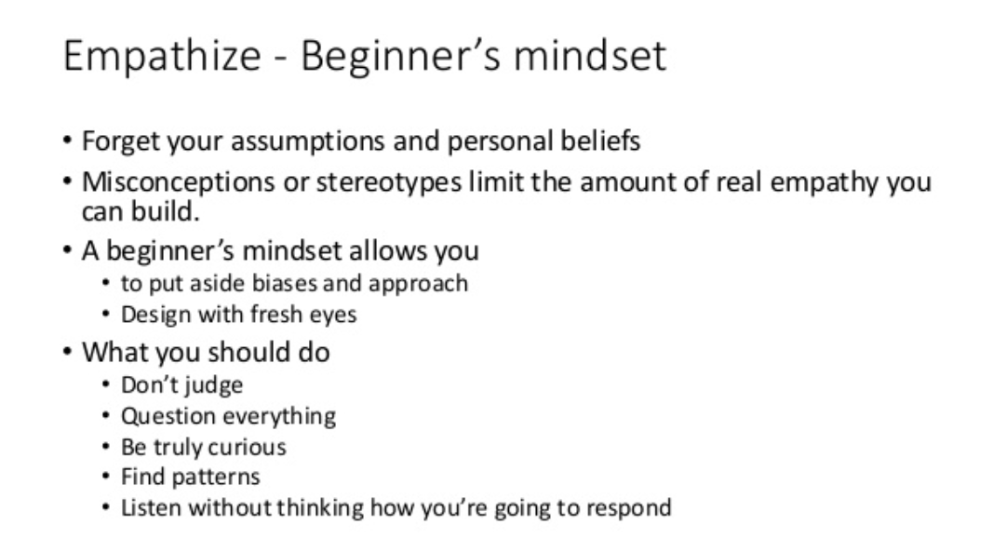


Slide 44
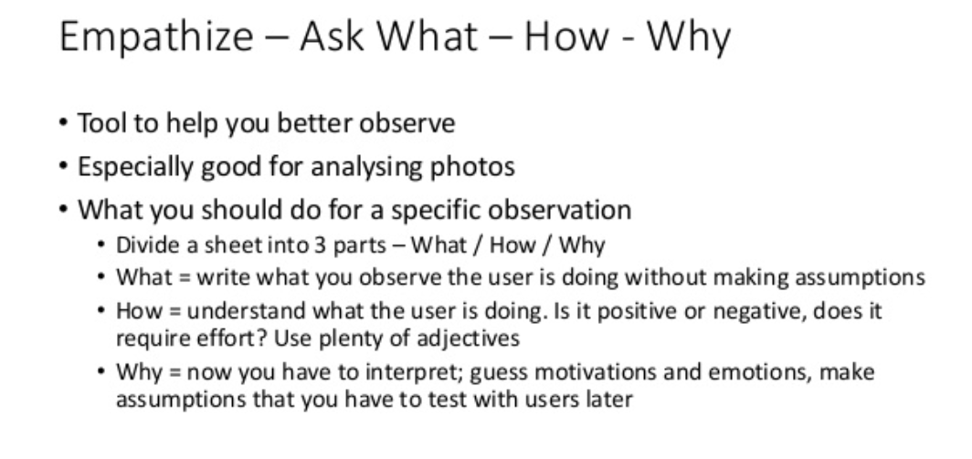


Slide 45
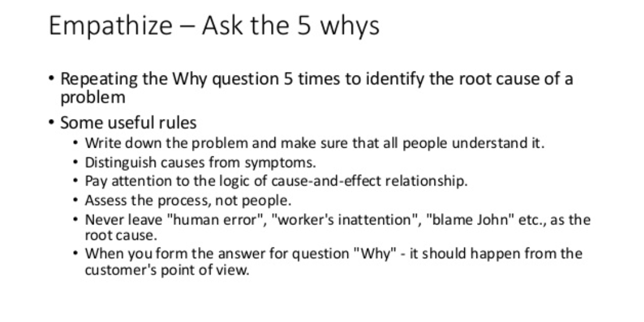


Slide 46



Slide 47


Slide 48
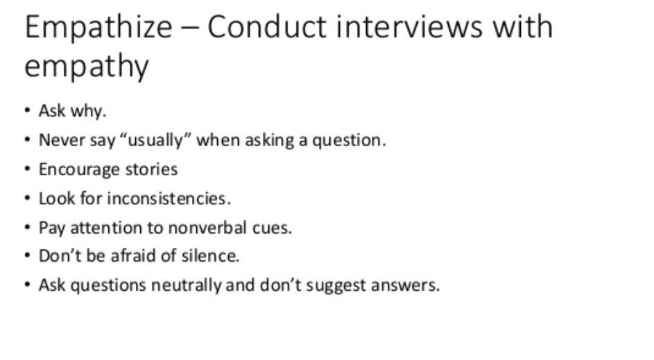


Slide 49
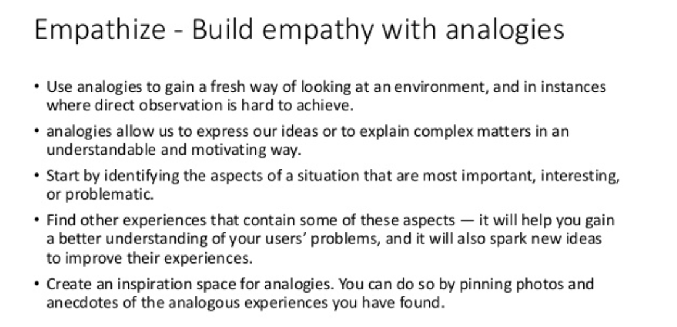


Slide 50
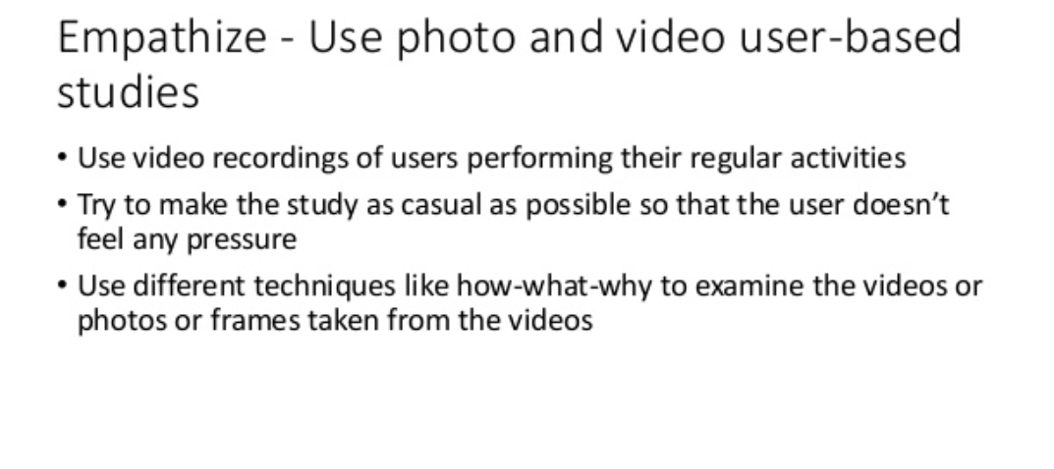


Slide 51




Slide 52
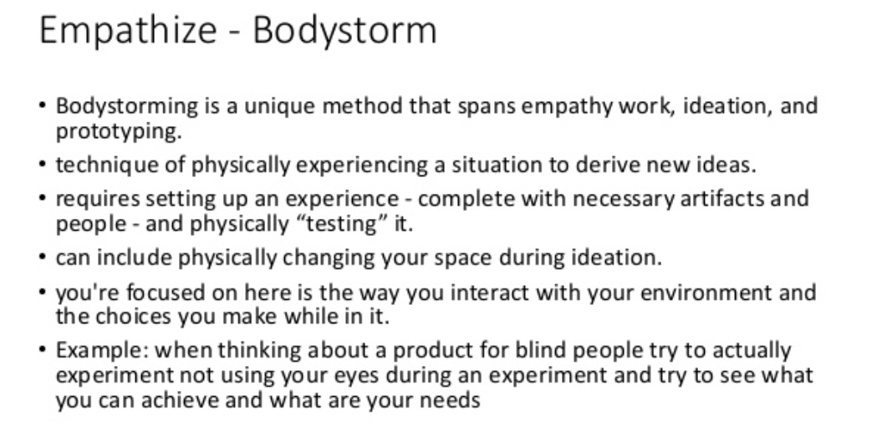

Slide 53
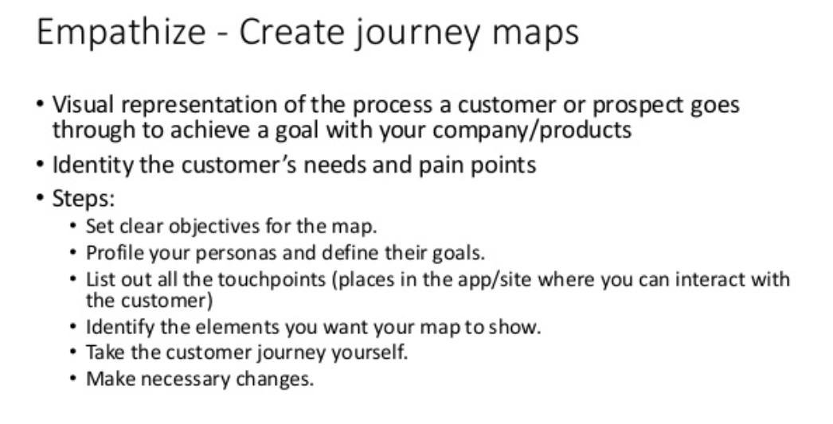

Slide 54
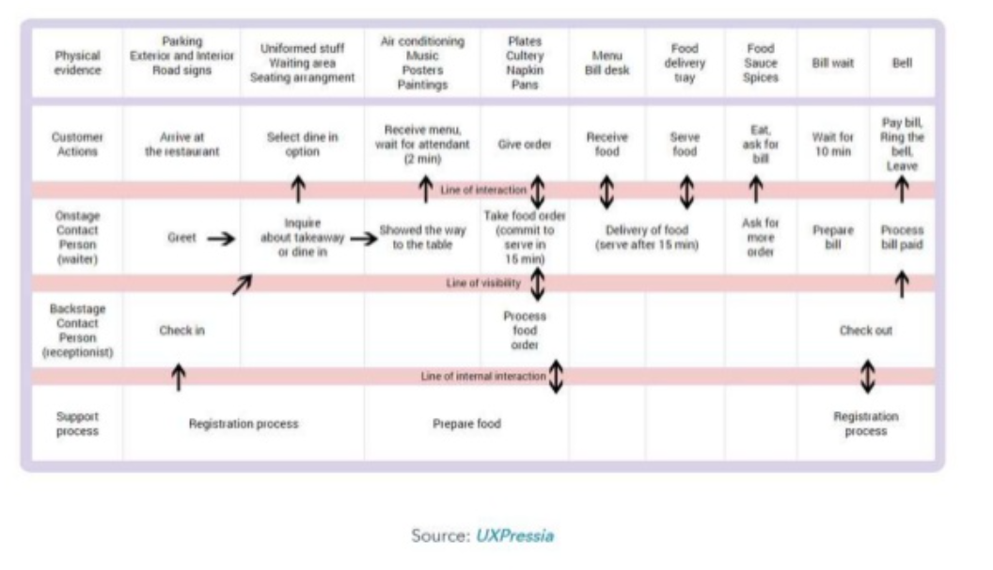

Slide 55
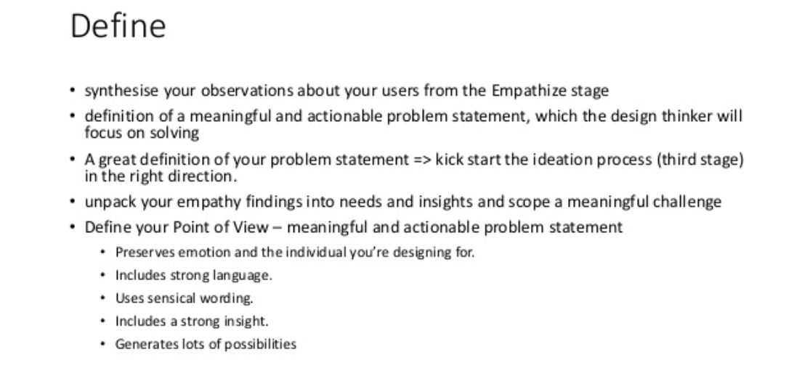


Slide 56


Slide 57
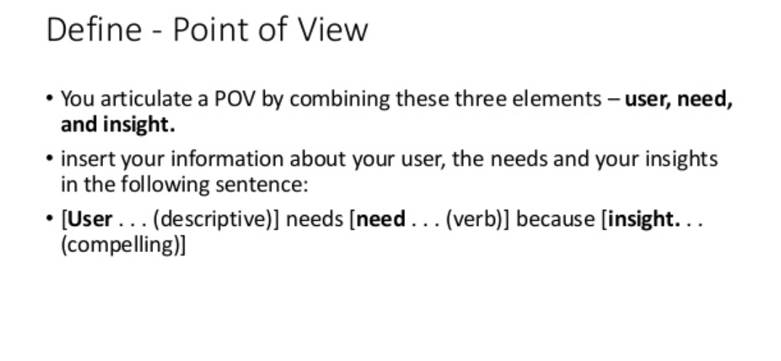


Slide 58



Slide 59


Slide 60
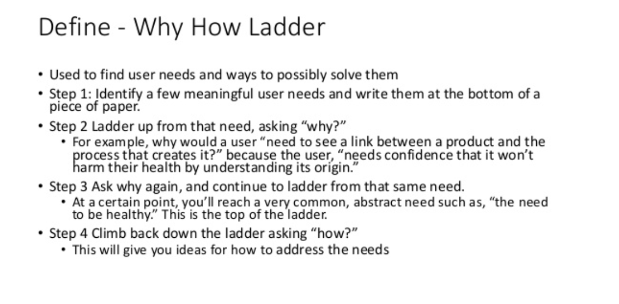


Slide 61
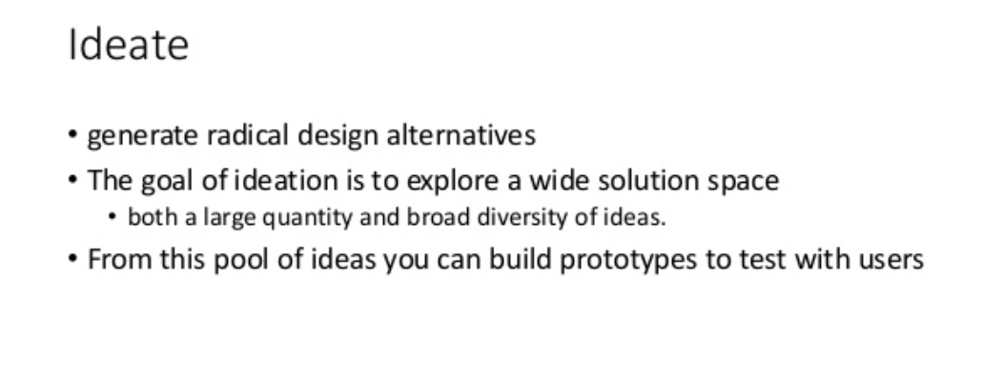


Slide 62
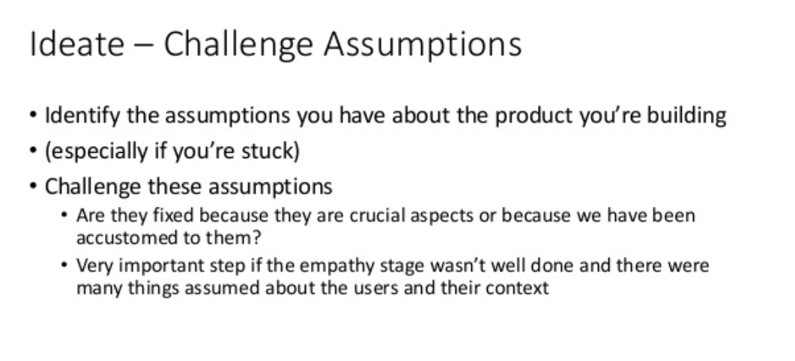


Slide 63
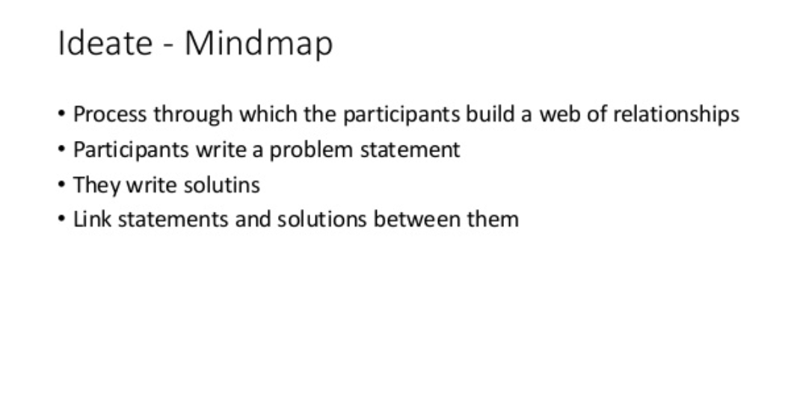

Slide 64


Slide 65
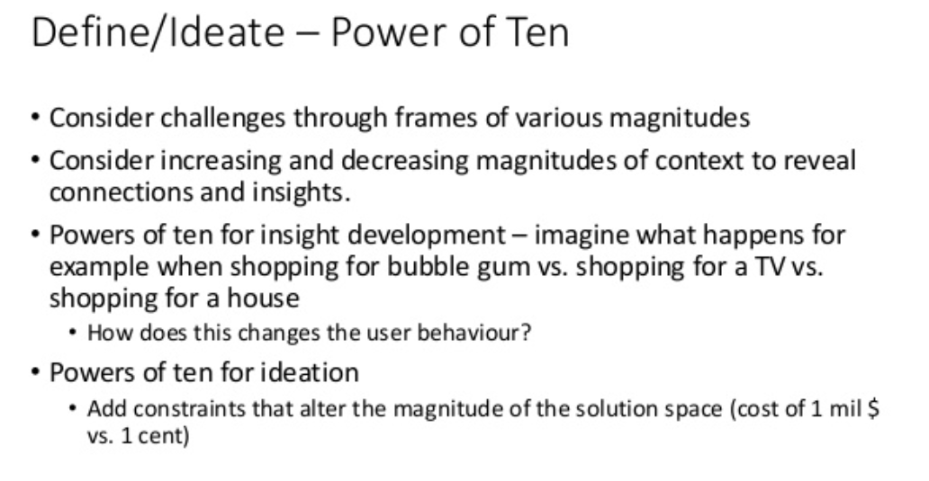

Slide 66
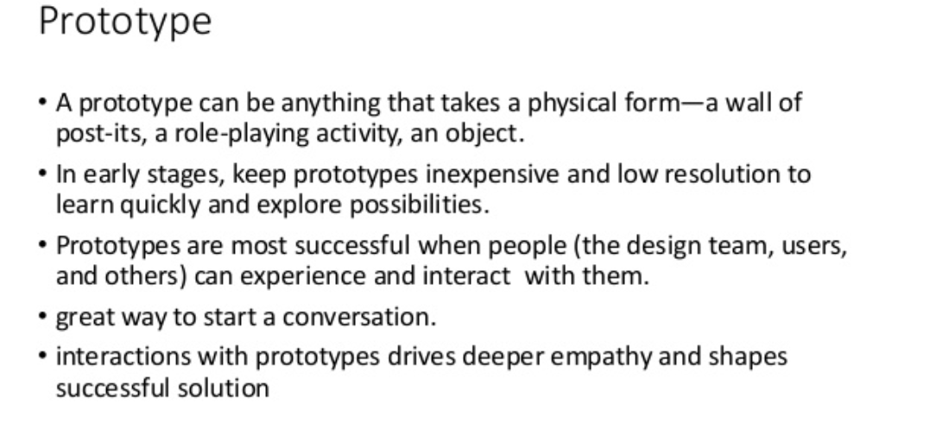


Slide 67
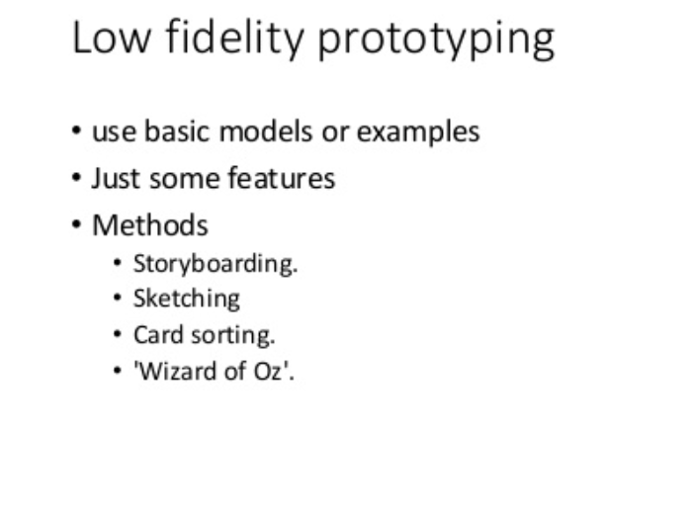

Slide 68
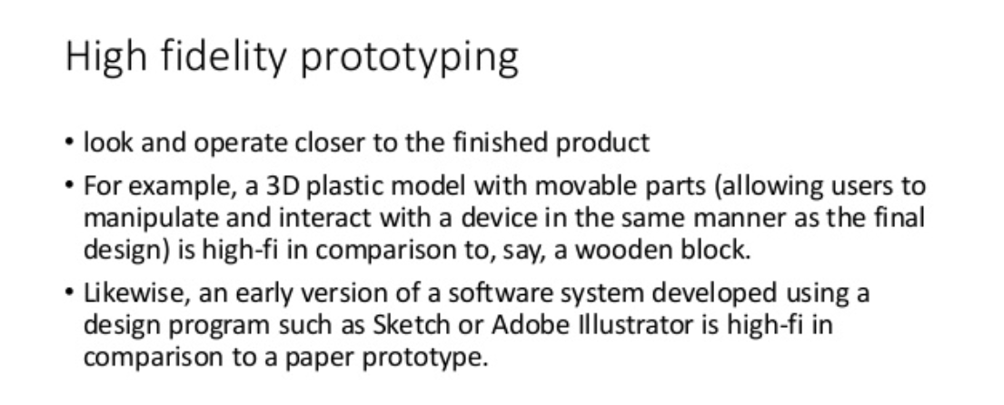

Slide 69
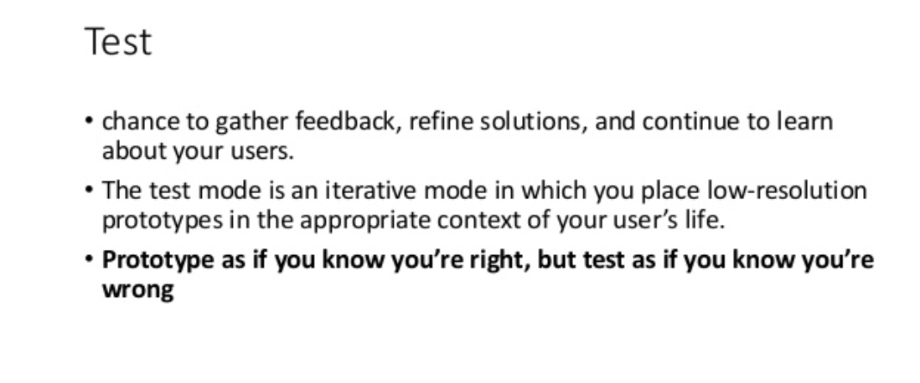

Slide 70
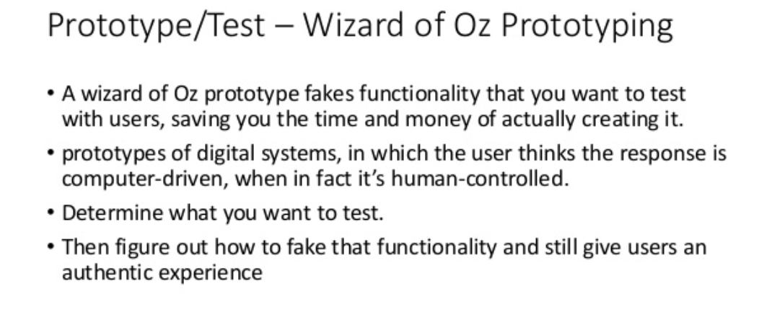


Slide 71
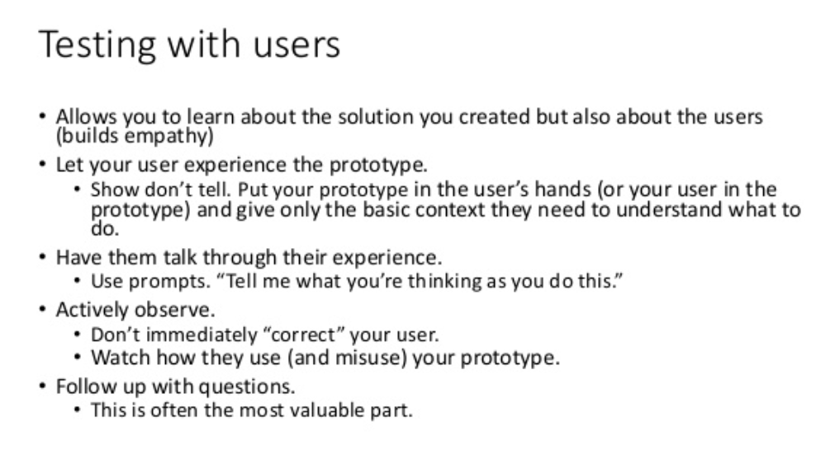


Slide 72

Lean Startup
Lean Startup provides a scientific approach to creating and managing startups and get a desired product to customers' hands faster.
The Lean Startup method teaches you how to drive a startup-how to steer, when to turn, and when to persevere-and grow a business with maximum acceleration.
It is a principled approach to new product development.
Too many startups begin with an idea for a product that they think people want.
They then spend months, sometimes years, perfecting that product without ever showing the product, even in a very rudimentary form, to the prospective customer.
When they fail to reach broad uptake from customers, it is often because they never spoke to prospective customers and determined whether or not the product was interesting.
When customers ultimately communicate, through their indifference, that they don't care about the idea, the startup fails.

Slide 73
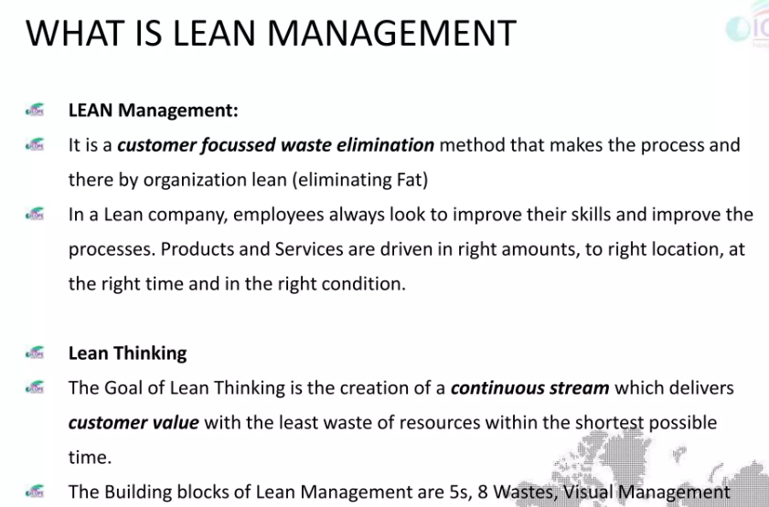

Slide 74
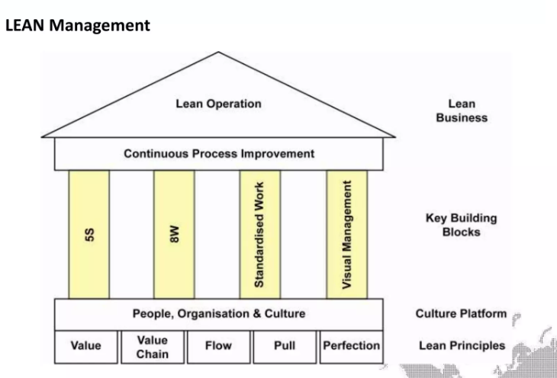

Slide 75
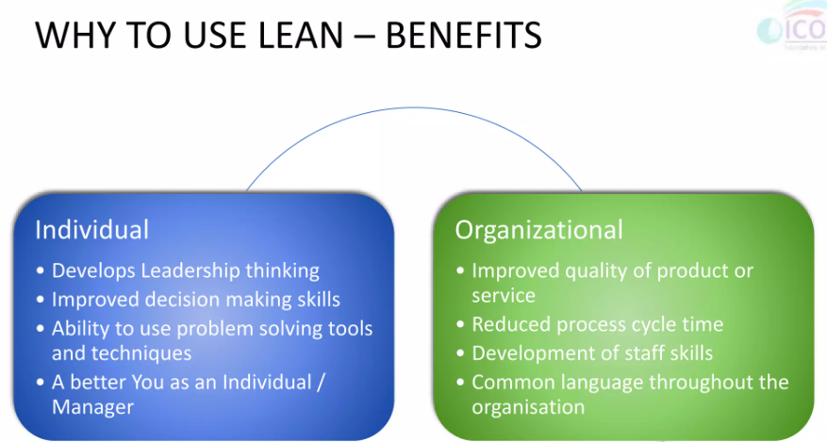

Slide 76
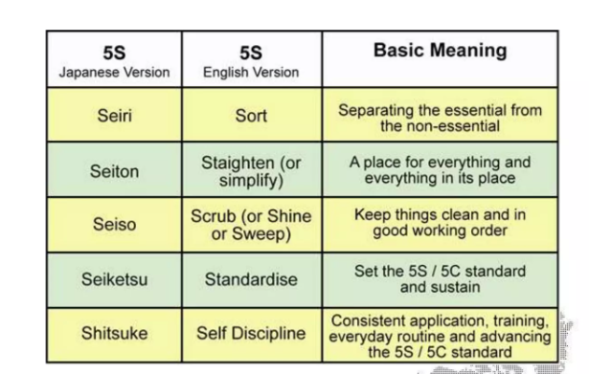

Slide 77
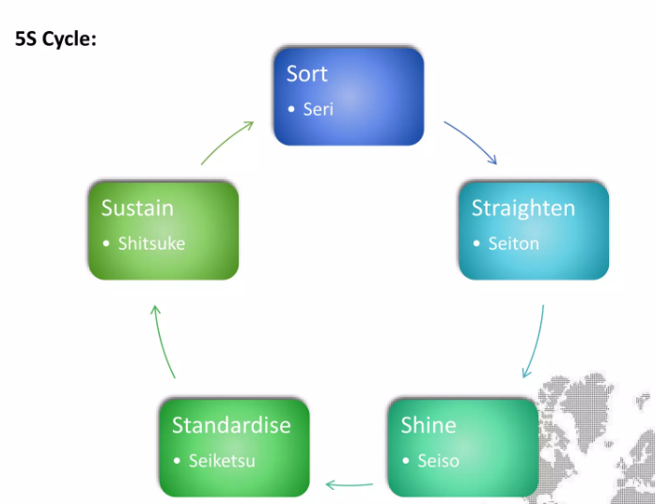

Slide 78

TYPES OF WASTES

Slide 79


Slide 80


